Slide 1


GAME FOR DYSLEXICS (Project by MPVIR group )

Slide 2



OUR TEAM
Member 1
Nayab Amir
FA16-BCS-322 nayabamir15@gmail.com
Member 2
Noor e eman
FA16-BCS-286
nooreman631@gmail.com
Supervisor
DR. Usama Ijaz Bajwa
Associate Professor and Head Of Department

Slide 3
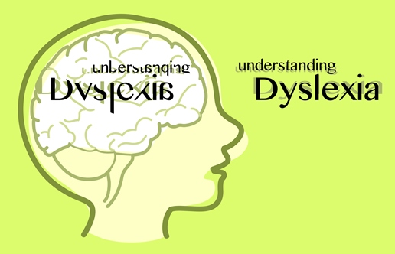
DYSLEXIA a reading disorder
INTRODUCTION:
A general term for disorders that involve difficulty in learning to read or interpret words, letters, and other symbols, but that do not affect general intelligence.

Slide 4

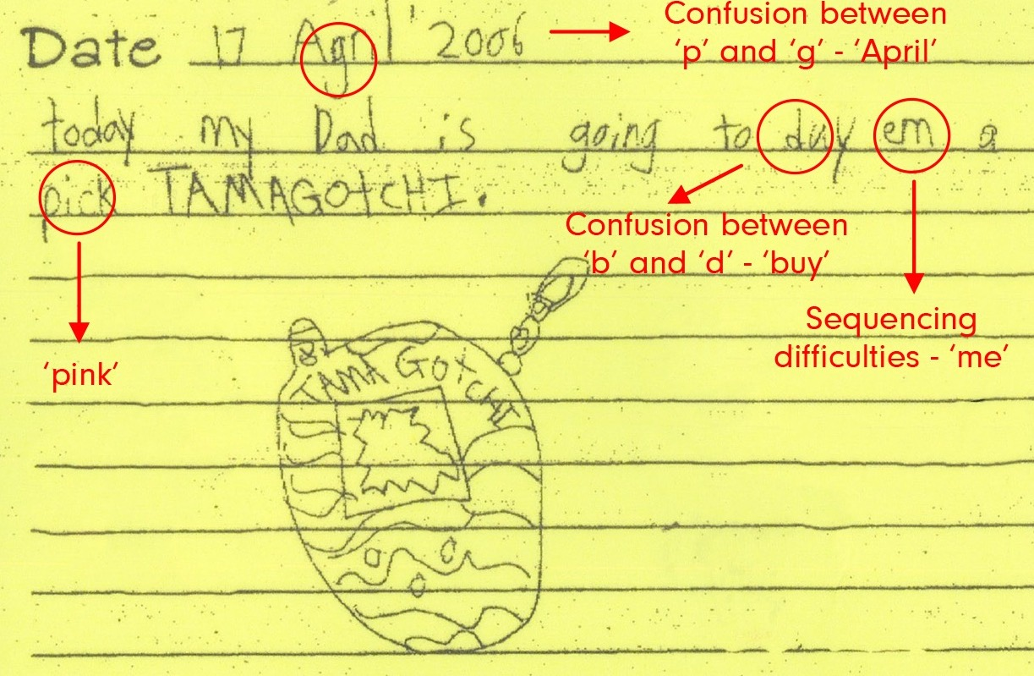
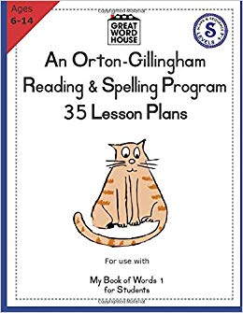
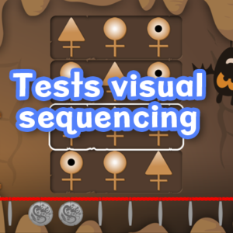
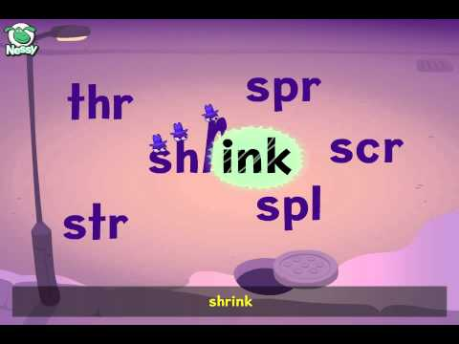
Primitive ways.
Idea of
“Game for Dyslexics”
About 5 to 10% of total population face dyslexia.
Daily life functioning is affected.
Primitive ways are rather boring and increase dropouts.
New technical ways

Slide 5


SERIOUS GAMES A SOLUTION
To make children learn more and remain engaged in the activity we should devise a new innovative way that is easy for both DYSLEXICS and SLPs.

Slide 6

Objectives
Detects likeliness of having dyslexia(Diagnosis).
Provide a platform for dyslexic children to improve their skills.
Attract Interest and decrease the school
dropout's percentage.
Facilitate SLPs and parents.
Keep track of subject’s progress.
Provide exercises on individual skills.
Game for dyslexics

Slide 7

Problem Statement
A portable rehabilitation tool.
All(cognitive abilities) in one game.
Effective learning of subject and decrease dropouts.

Slide 8



Uniqueness:
A set of strategy games integrated in one.
Diagnosis game.
Progress Graph.
Related work
DocLexi: Learn to Read & Spell.
Eye games, Dyslexia.
Dyslexia Test.
Lexercise Online Language-Literacy Processing Evaluation.

Slide 9




Tools and Techniques
Tools:
Unity 3D Engine.
C Sharp(backend).
2D sprites using photoshop.
Android support.
Techniques:
Orton Ganllengium Curriculum.
Standardized tests for dyslexia evaluation.

Slide 10
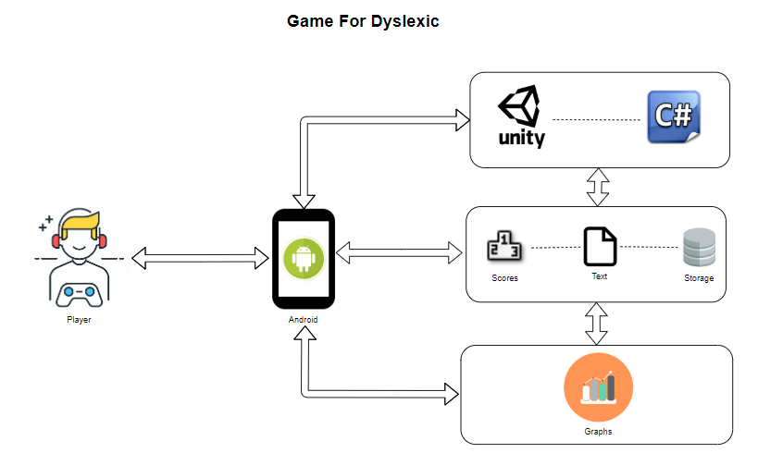
System Architecture

Slide 11
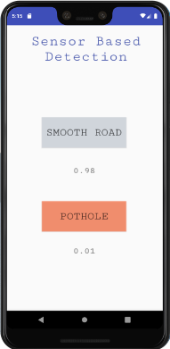
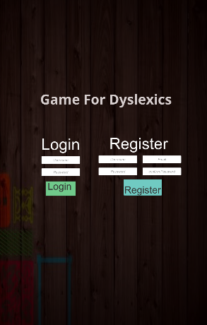
APP INTERFACE
LOGIN MENU

Slide 12

Modules (two basic modules)
APP INTERFACE

Slide 13
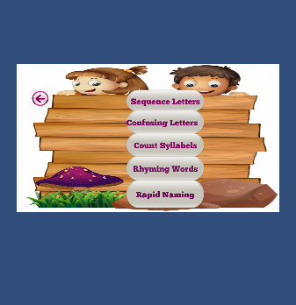
Rehabilitation (training the cognitive abilities)
APP INTERFACE

Slide 14
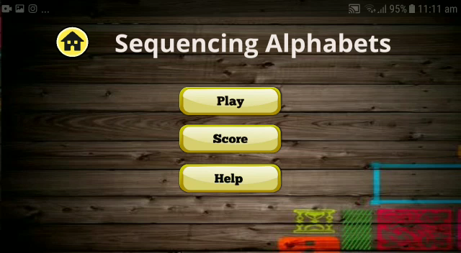
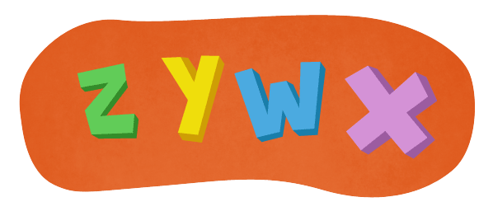
Sequence Alphabets
visual Sequential Memory
Sequencing Test
WOM-ASM
Evaluated cognitive abilities.
Time.
Levels.
Examples
Days in week
Months of year.

Slide 15
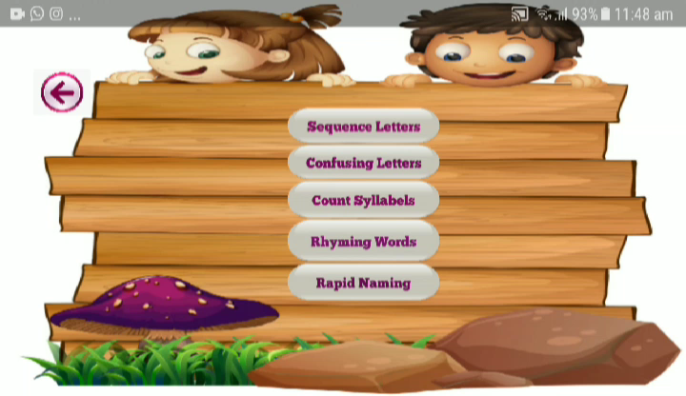
Confusing Alphabets
Eye Tracking Problems
Mirror writing. e.g. saw -was
B-d.
Dysgraphia.

Slide 16
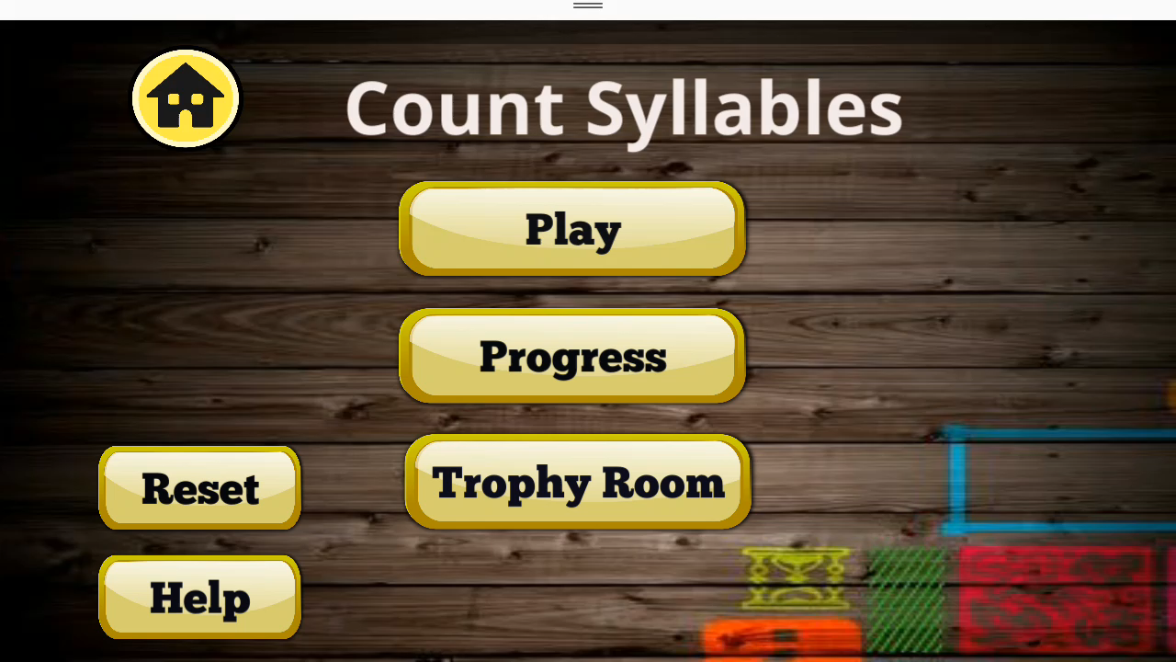

Count Syllables
Test of Auditory Processing Skills, 3rd Edition (TAPS-3).
unit of pronunciation having one vowel sound.
phonological awareness.
Pronunciation of words with lots of syllables.

Slide 17
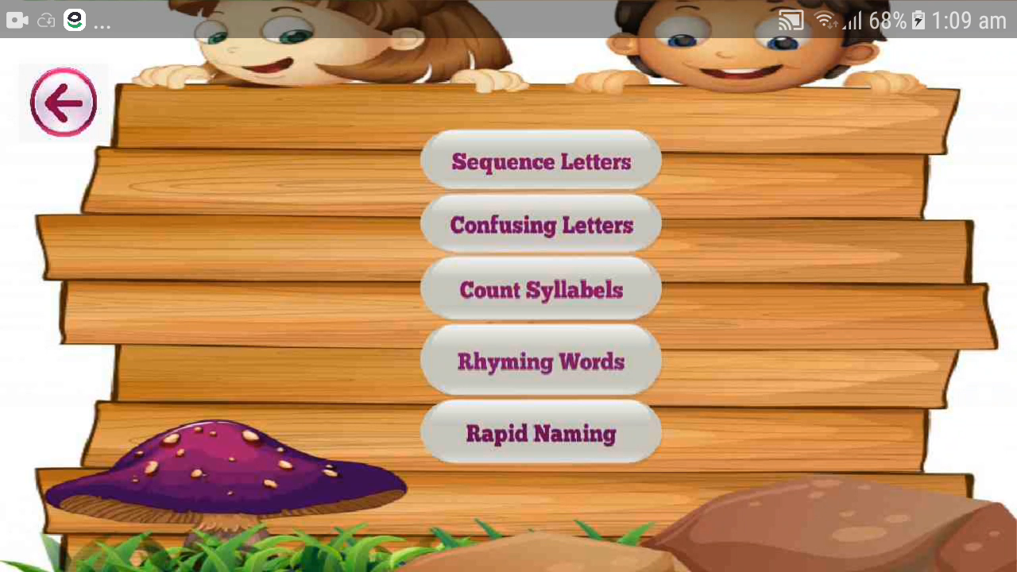
Rhyming
Phonological awareness.
(assessment 5 - 8).
Recognizing rhythmic sounds and mapping the images.
Blending sounds.
Results

Slide 18
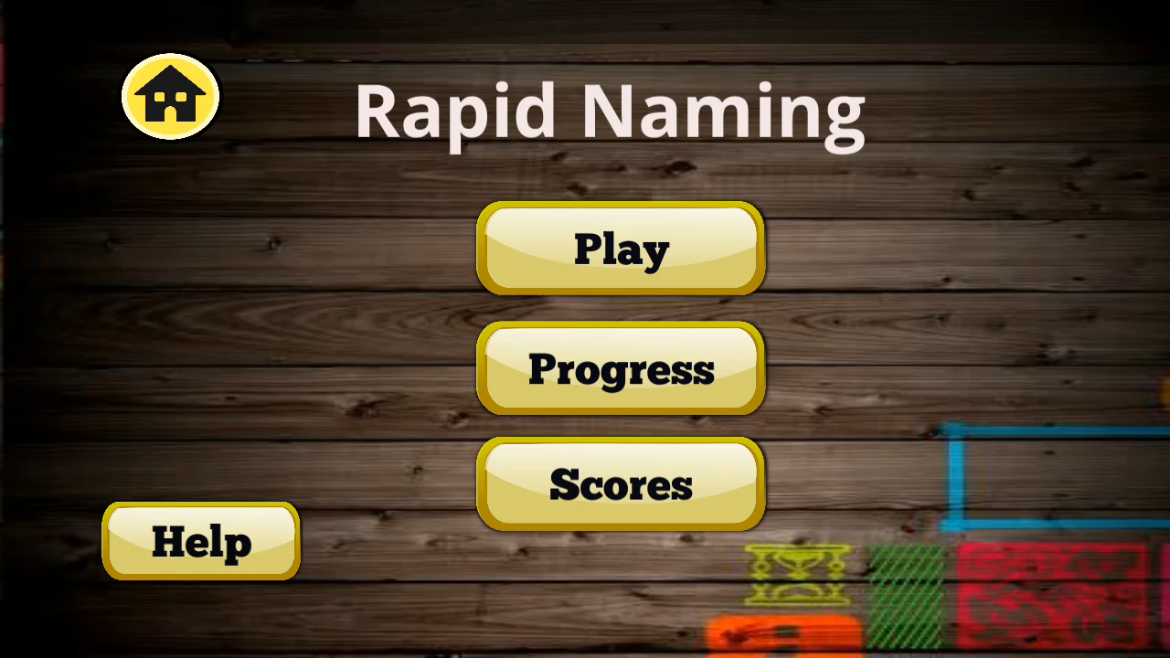
Rapid naming
Rapid Automatized Naming test(RAN)/Speed test.
Grapheme-phoneme relation
5 Tenets of Reading
Phonemic Awareness
Phonics
Fluency
Vocabulary
Comprehension

Slide 19
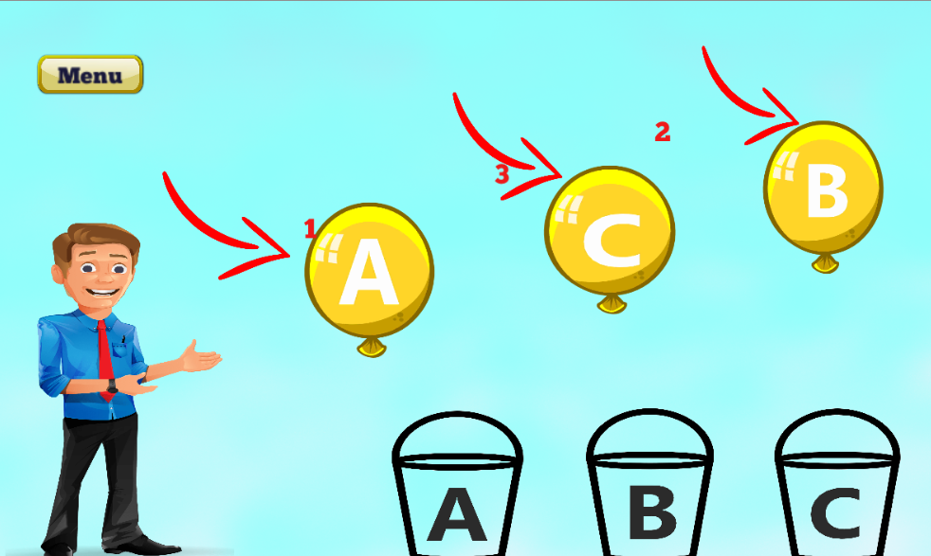
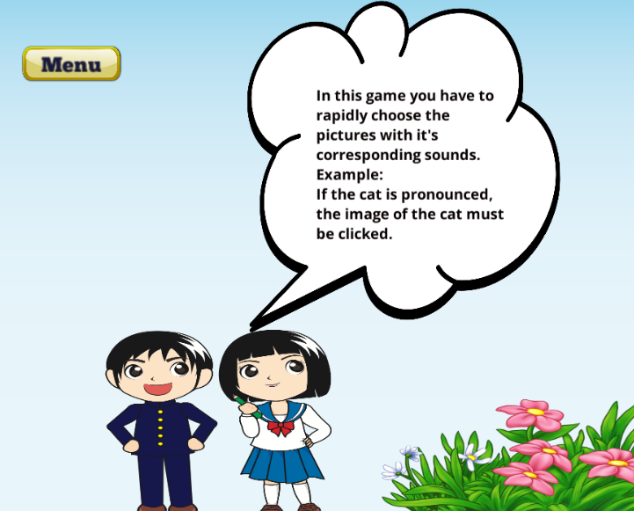
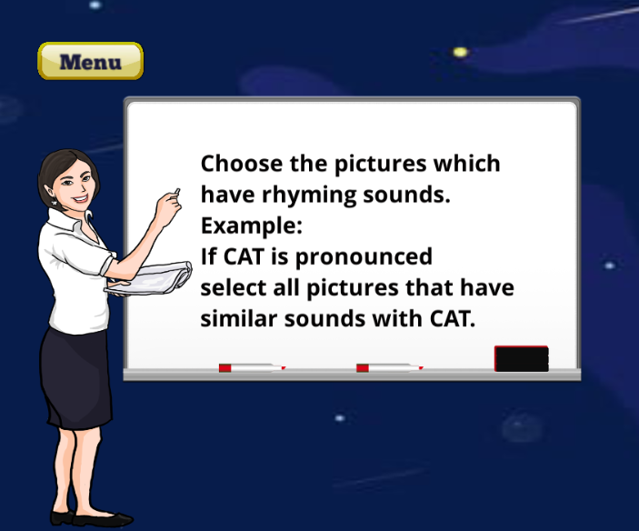
Tutorials
Instruction following ability.
Memory retention.
Tutorials before each game.

Slide 20

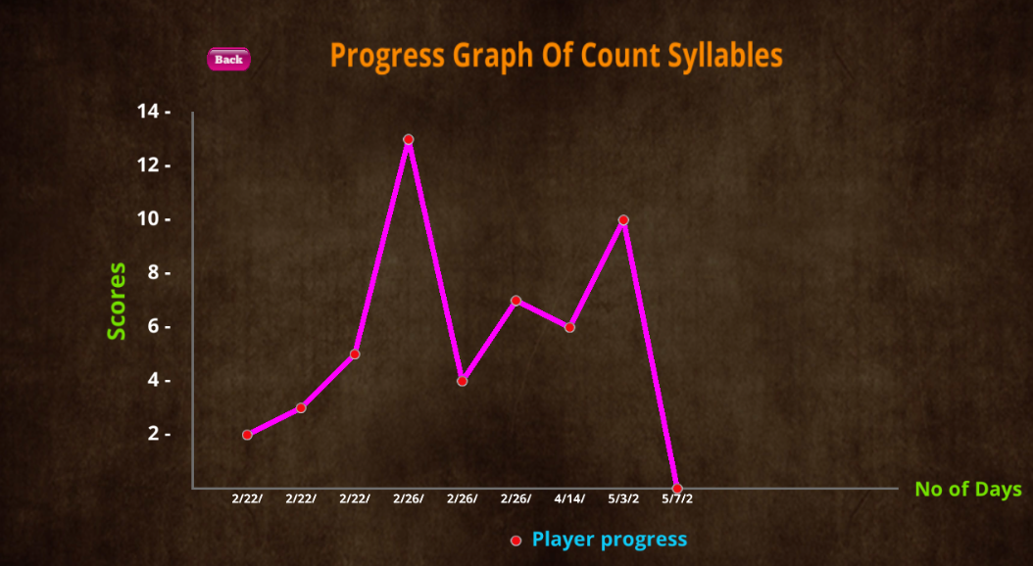
Progress Graph
Maintains progress of each game.
Parents/SLPs can have a look and monitor improvement.
Scores for some game while time for other is taken as assessing criteria.
Scores on y axis and number of days date wise is place on x axis.
Curve shows progress of individual.

Slide 21




Diagnosis
Set of scenes on all abilities covered in rehabilitation.
Scene for arranging days of weeks and months of year.(Sequence)
Scene on naming colors(speed test).
Scene on phonics auditory skills(vowels hearing ability).
Scene on instruction following ability(memory test).
Results
If the subject is unable to perform well in any one of the tasks then he is likely to have dyslexia.

Slide 22


Conclusion
Game for dyslexics would help subject understand the relationship between phoneme and grapheme.
Help connection between words and thoughts.
The subject would be able to follow directions and find paths easily.
Class dropouts will decease.
Effective learning.

Slide 23

Future work
Difficulty levels according to age will be introduced.
Improvement in diagnosis game.
Games on other types of dyslexia will be added .ie
Dyscalculia.
Dysgraphia.
Introduce games on more cognitive skills.

Slide 24


SOCIAL
MPVIR
GitHub
Our Work is cited at Machine Perception & Visual Intelligence Research Group
https://sites.google.com/view/mpvir/
Find our Work at GitHub
https://github.com/Nayab15/game-for-dyslexic

Slide 25

Thank You

